Slide 1
Customer Satisfaction and Growth
GROUP 6

Slide 2
Customer Satisfaction and Growth
Our primary focus will be to address the high-level questions posed by our Head of Business Development:
How are we doing with customer satisfaction?
What does the data say about how we can grow our business?

Slide 3
Feature Engineering
'Product Profit': This calculates the profit per product (sales price - cost), which is crucial for understanding which products contribute most to the company's bottom line.
To Evaluate Growth potential we wanted combine the information in Customer Satisfaction and Profit to estimate how likely each location would be grow in the future. High values in these metrics could indicate stores or products that are both profitable and well-liked by customers, suggesting potential areas for business growth.
Total Growth Potential: Total Profit * Customer Satisfaction
Efficient Growth Potential: Profit Ratio * Customer Satisfaction

Slide 4
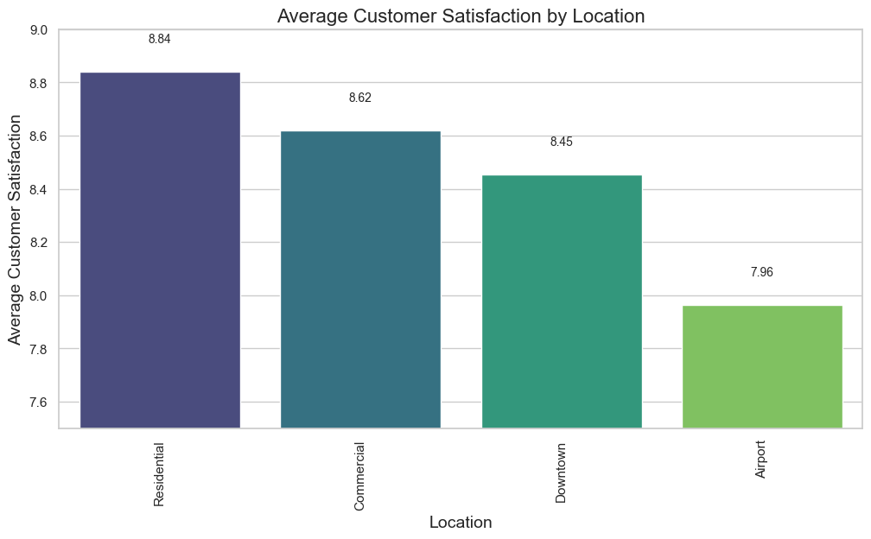
Location
Notes:
To understand the unique preferences and pain points of customers in different areas. Customers residing in residential areas generally have the most positive experiences, potentially due to factors such as convenience and personalized services. On the other hand, customers in airport locations tend to have the lowest satisfaction, which can be attributed to the inherent challenges and stress associated with travel.

Slide 5
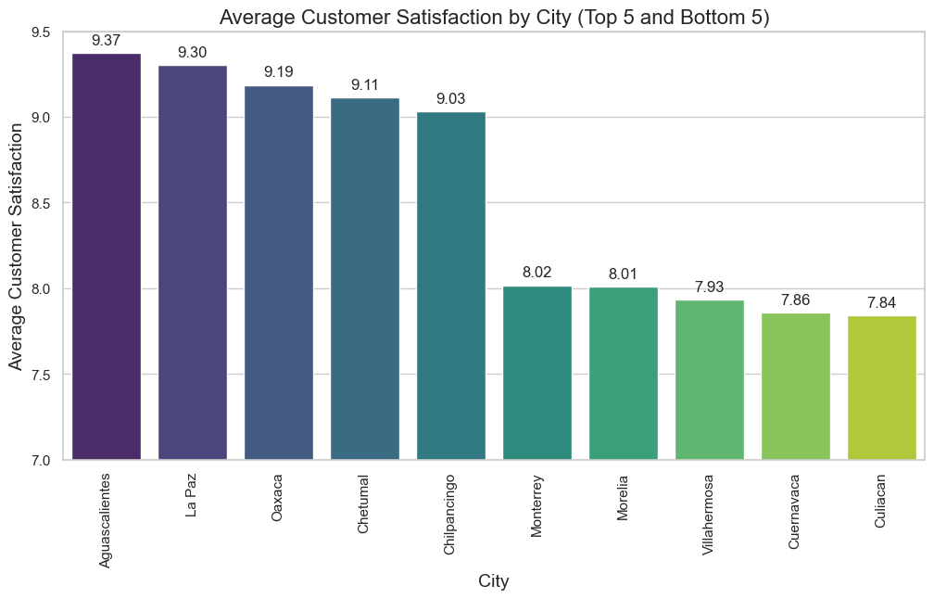
Location
Notes:
highlighting the success factors that contribute to their positive ratings vs areas for improvement

Slide 6
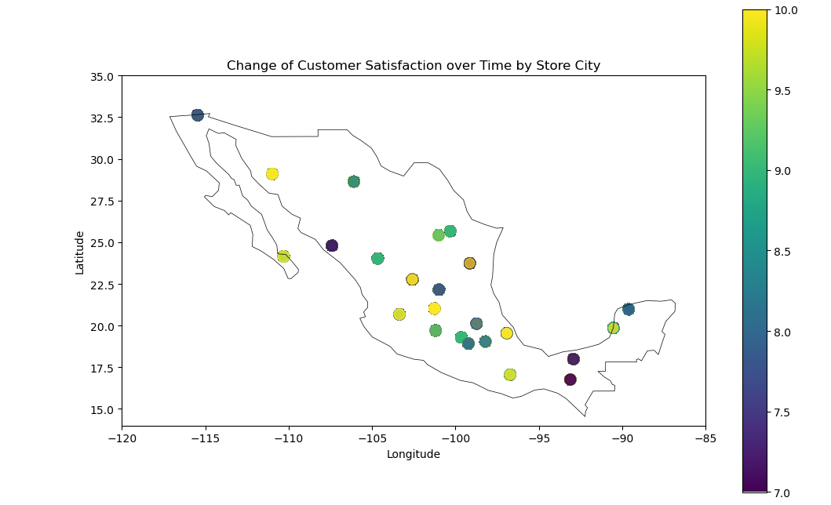
Location

Slide 7
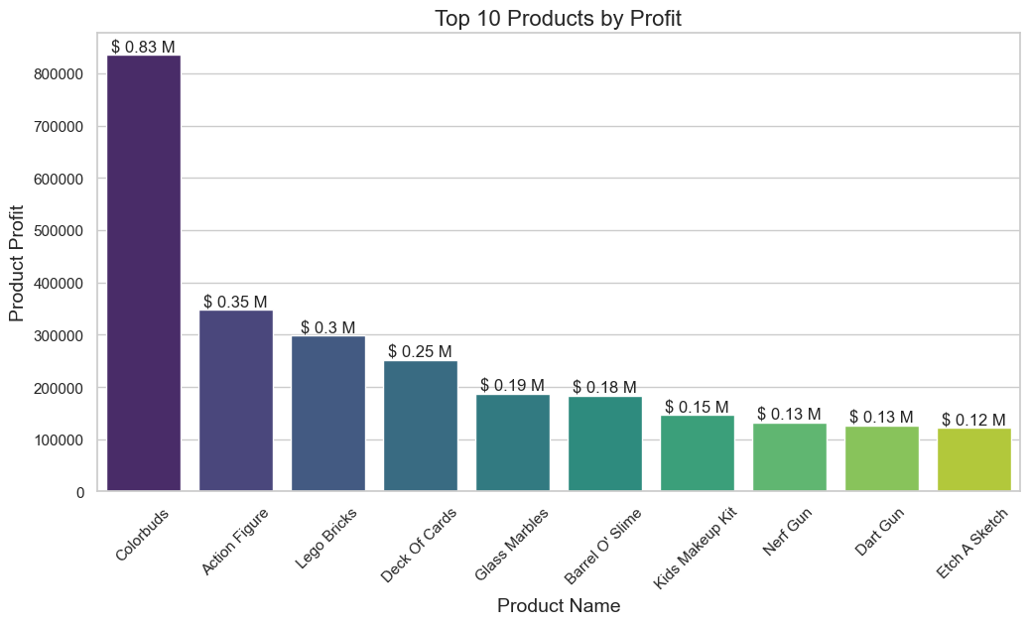
Most Profitable Products

Slide 8
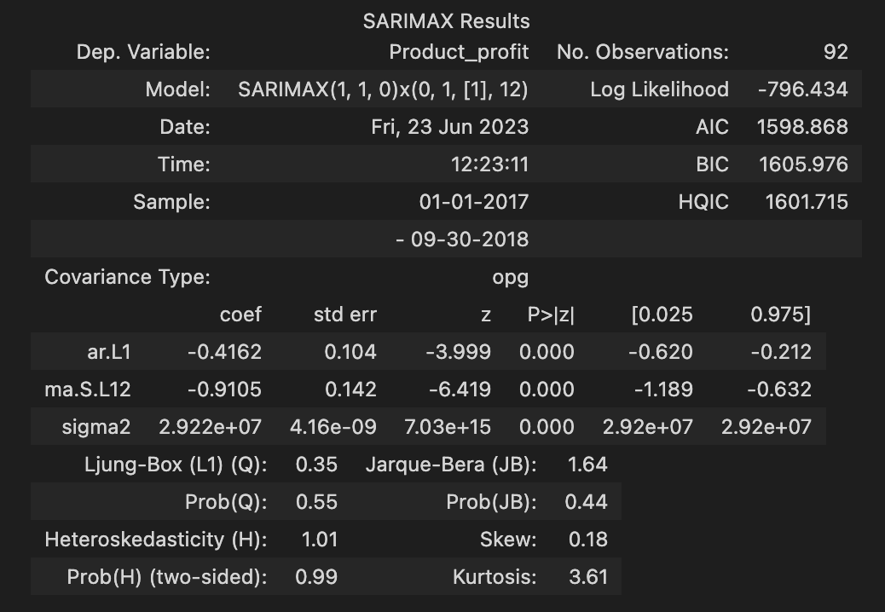
SARIMAX Results
The dataset was grouped into weekly profits and placed into a seasonal ARIMA Model.
The autoregressive term has a p-value that is less than the significance level of 0.05. You can conclude that the coefficient for the autoregressive term is statistically significant, and you should keep the term in the model.
Notes:
Auto ARIMA to get season to run SARIMAX
A seasonal ARIMA model is classified as an ARIMA(p,d,q)x(P,D,Q) model, where P=number of seasonal autoregressive (SAR) terms, D=number of seasonal differences, Q=number of seasonal moving average (SMA) terms
p = non-seasonal AR order, d = non-seasonal differencing, q = non-seasonal MA order, P = seasonal AR order, D = seasonal differencing, Q = seasonal MA order, and S = time span of repeating seasonal pattern
ARIMA(1,1,0)(0,1,1)[12]
The ‘coef’ column represents the significance of each feature.
ar.L1 refers to the autoregressive term with the lag of 1.
ma.L12 refer to the ‘moving average’ terms with lag of 12. All of these coefficients are part of the ARMA equation below. This example is a second-order model. The higher the number of lags you use in your model, the longer the equation will be.

Slide 9
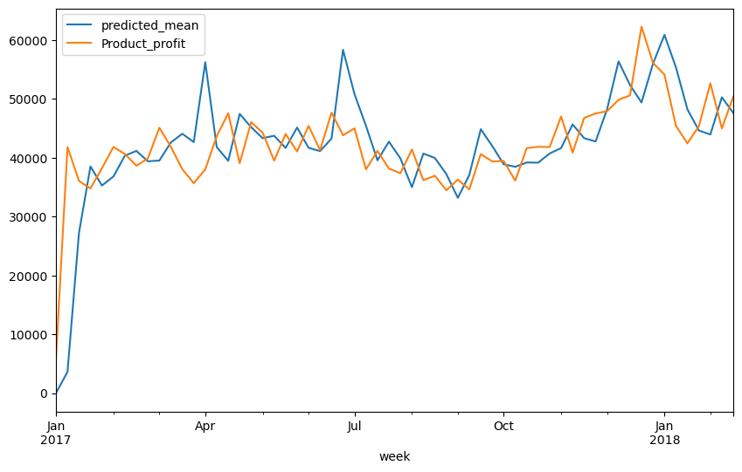
Prediction on Training Model (not overfitted)
Product profits compared against the predicted mean for our training model. Since there is a decent level of error between the two graphs, the model is not overfitted.

Slide 10
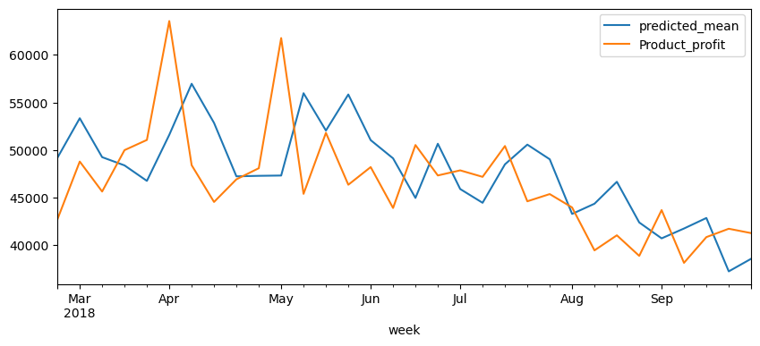
Prediction on Test Model
Product profits compared against the predicted mean for our test model.

Slide 11
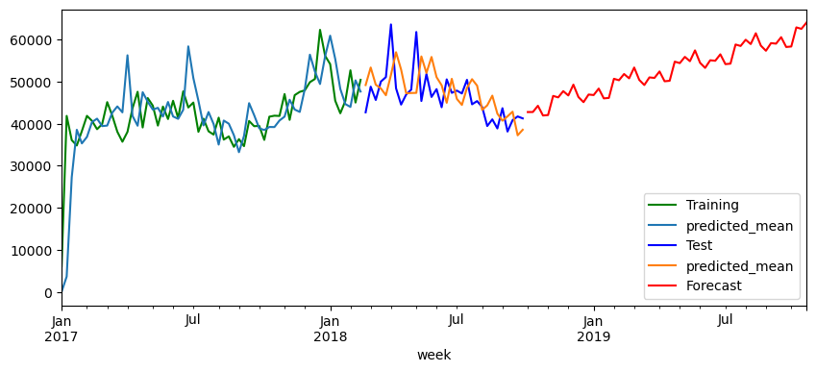
Forecasted based on the Model
Forecast using our model.

Slide 12
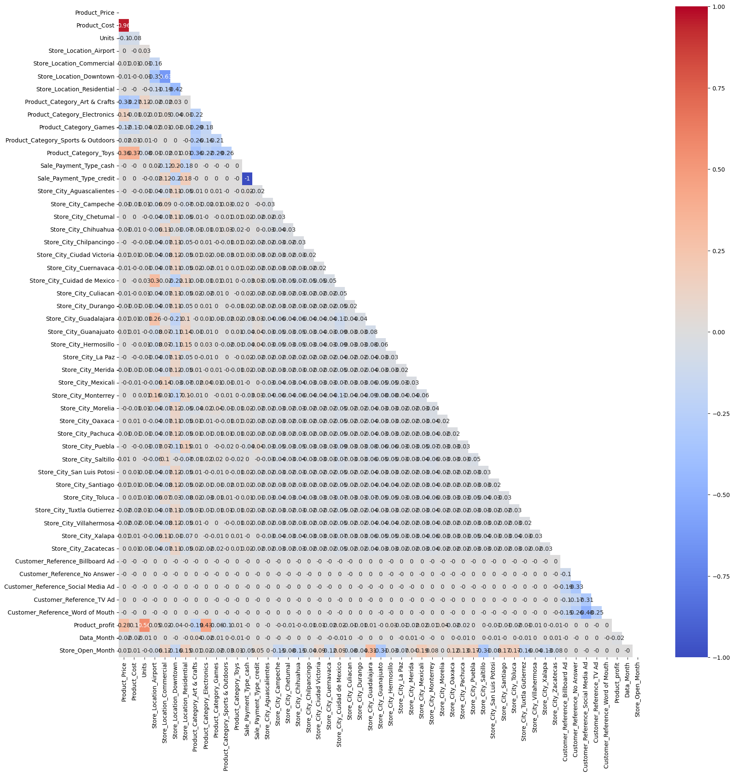
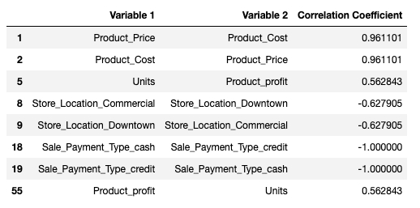
47 variables
Threshold = 0.5

Slide 13
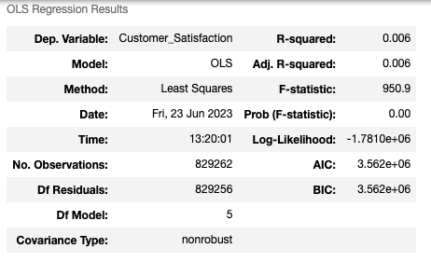
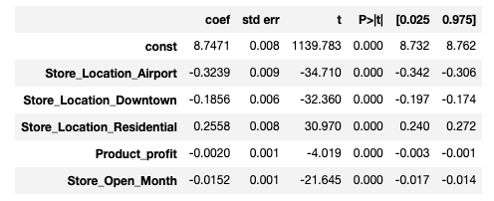
Linear Reg Model
R-squared = 0.006
Dependent variable: Customer satisfaction
Independent variables:
'Store_Location_Airport', 'Store_Location_Downtown', 'Store_Location_Residential', 'Product_profit',
'Store_Open_Month'

Slide 14
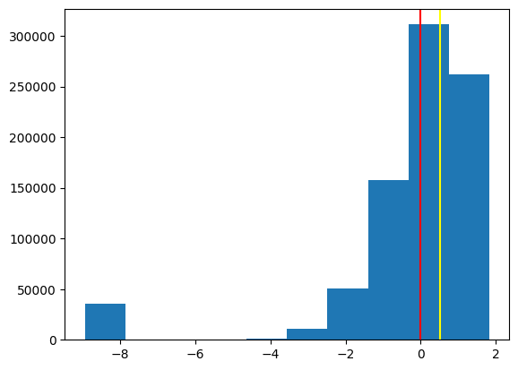
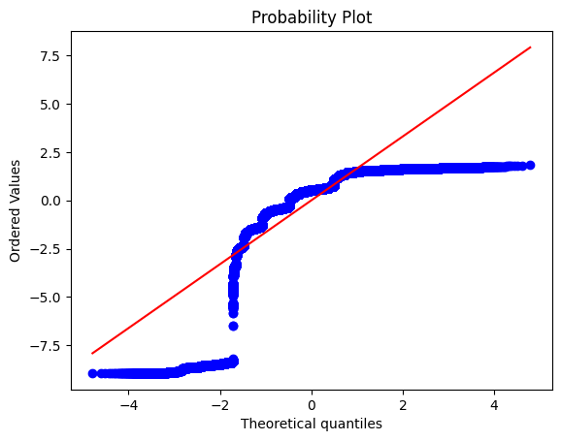
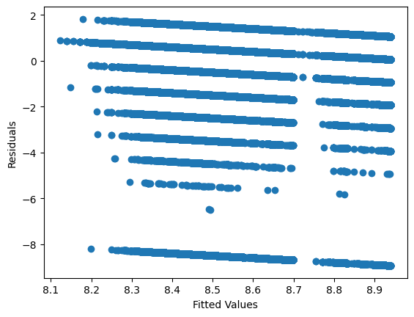
Shapiro-Wilk test on residuals: p-value = 0.0
Not a normal distribution
Left-skewed
Potential presence of heteroscedasticity
NOT a good linear model - very weak relationship

Slide 15
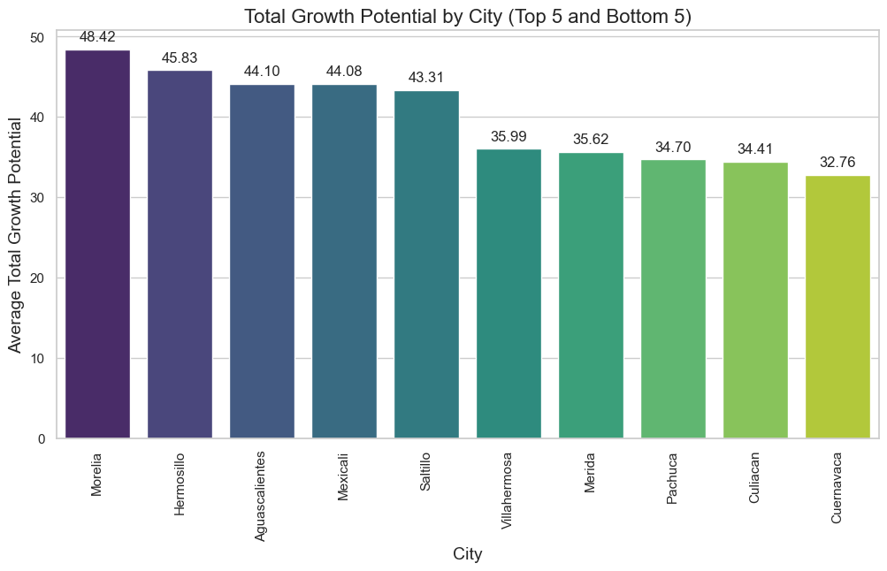
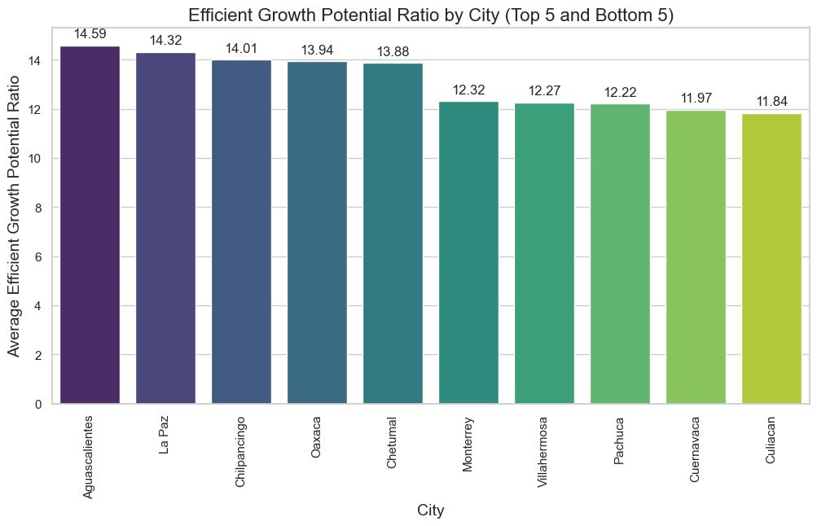
City Growth Potential
Total Profit * Customer Satisfaction
Profit Ratio * Customer Satisfaction
The top 5 are Morelia, Hermosillo, Aguascalientes, Mexicali, Saltillo
The bottom 5 Villahermosa, Merida, Pachuca, Culiacan, Cuernavaca
The top 5 are Aguascalientes, La Paz, Chilpancingo, Oaxaca, Chetumal
The bottom 5 Monterrey, Villahermosa, Pachuca, Cuernavaca, Culiacan

Slide 16
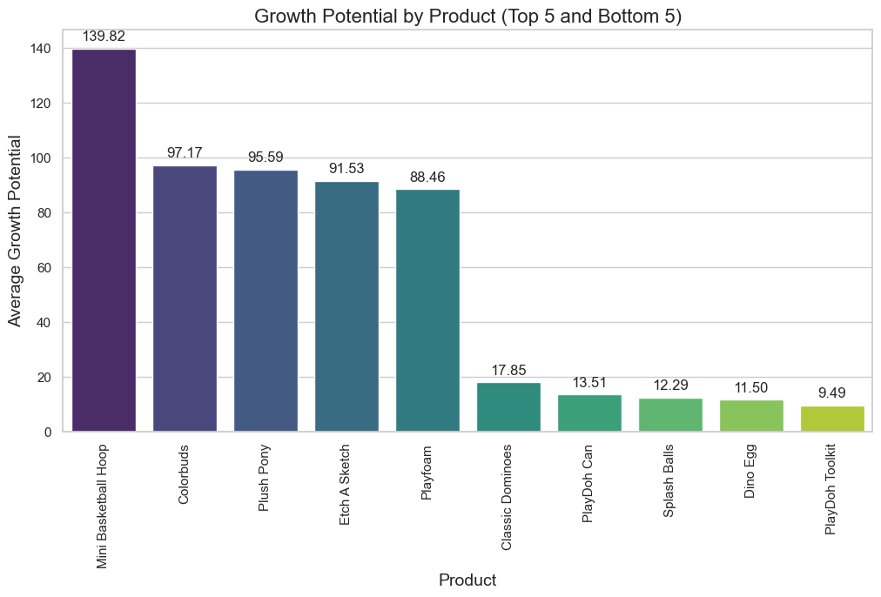
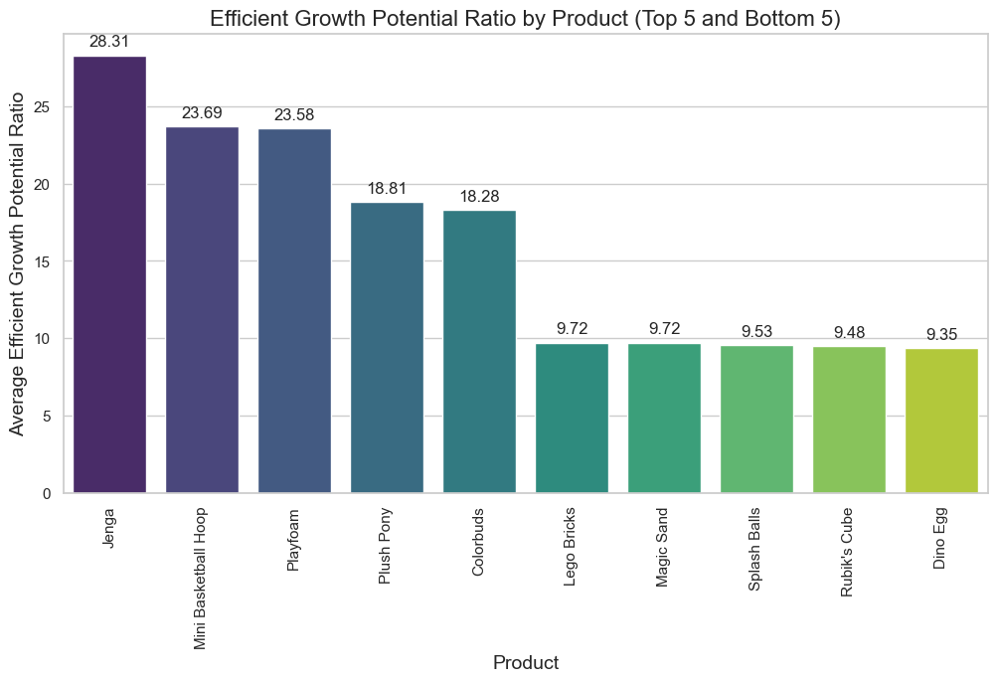
Product Growth Potential
Total Profit * Customer Satisfaction
Profit Ratio * Customer Satisfaction
The top 5 are Mini Basketball Hoop, Colorbuds, Plush Pony, Etch A Sketch, Playfoam,
The bottom 5 Classic Dominoes, PlayDoh Can, Splash Balls, Dino Egg, PlayDoh Toolkit
The top 5 are Jenga, Mini Basketball Hoop, Playfoam, Plush Pony, Colorbuds
The bottom 5 Lego Bricks, Magic Sand, Splash Balls, Rubik's Cube, Dino Egg

